Slide 1
IoT Enabled Social Web Framework for Water Consumption Monitoring
Group No. 14
By-
Nakul Gagare(18204013)
Krutika Pawar(18204012)
Deeksha Kadam(18204007)
Project Guide -
Prof. Yaminee Patil

Slide 2
Content
Introduction
Objectives
Problem Definition
Technological Stack
Review Suggestions
Proposed System Architecture/Working
Prototype Design Demonstration.
Plan of Paper Publication

Slide 3
Introduction
Currently, in world full of technologies the water is the basic and most important need to our lives
Currently, the water department is using the water pump to measure the supply of water to particular area & societies
In which, the pumps are fitted on the ground and according the measure is counted as per month
But in process the officers has to personally visit the area to take the reading of the meter
By using this technology ,we can send the reading to the authorized officer without personally visiting the area
The report can be generated the usage of water and the quantity of water consumed in a day

Slide 4
Objectives
Developing the ecosystem for smart water supply.
Get the quantity of water supplied to area and analysis the water level present in tank.
observing the water supplied to area and analysis the water quality present in tank.
All the reading can analysis & helpful to water department to the problem of water scarcity in the town.
By analyzing this, the report can generate which can tell usage of water.
By using Elastic Stack designing the dashboard for the department end user

Slide 5
Problem Definition
We observed that for the most part the employment is manual and requires a sensible technology to give organized distribution.
To convert the manual water supply reading system to a automated sensor used dashboard
To check the quality of the water which is provided in tank
Get the accurate reading and mapping of the supply of water in the town.
No officer can change the reading which leads to corruption.
By using this we can future analysis the wastage of water.

Slide 6
Technological Stack
Hardware requirements:
Water Level Sensor
Water Flow Meter
Arduino Uno -ATmega328
Wifi Module
Water Quality Sensor
Software Requirements :
Browser: Google chrome , Mozilla Firefox
Application : ELK Stack ,Android Studio,HTML
Elastic Cloud

Slide 7
Review Suggestion
Implement web interface (Dashboard).
For Dashboard use Webpage HTML
Dashboard should work in background continuously and analysis value.
Fetch Daily, monthly, Yearly reports .
Store your Data in the Cloud.
It should be User Friendly
To measure the Quality of the Water supplied to the tank

Slide 8
Proposed System (Working)
Reports of Water Consumption & Water Level will be Visible in Gov – Website & Society - App
Water supplied to society tank passed through Water-Flow Meter
Through this ,the reports will be Generated on Daily ,Weekly ,Monthly Bases
Water-flow meter measure the quantity supplied to Tank
By using , ELK Stack the values will be analyzed & Visualized
Analysis the Quality of water supplied to the tank.
Values will fetch from Cloud to Website
Water Level Sensor placed in Tank To measure the Balance Quantity of Water
Both The Data will stored in cloud

Slide 9
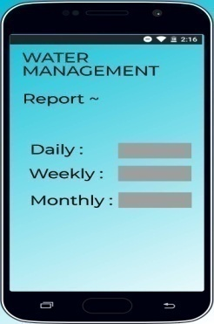
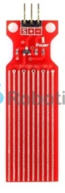
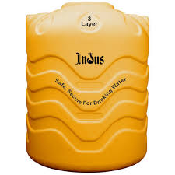
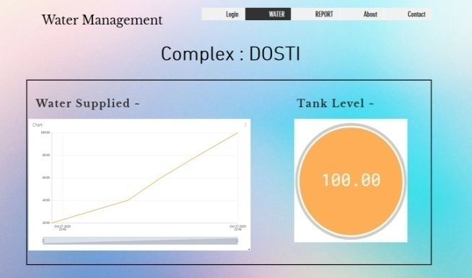

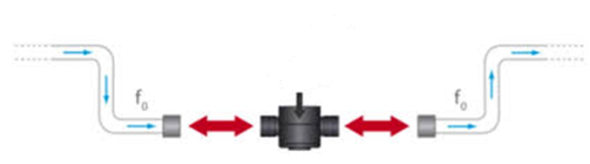

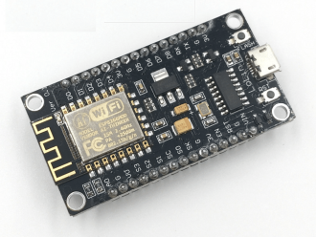

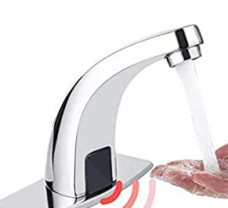

Proposed System (Architecture)
START
8. Society App to see generated report from WD
(only for
society secretary)
1.Tank
END
2. Water Level Indicator
3. Water Quality
Module
4. Water
Flow Sensor
Dashboard
for generate
report
(Admin)
7. Water Department
(Admin)
5. Wi-fi Module
* Human Sensor Tap
6. Store data in the cloud

Slide 10
Working of Application/Technologies :-
Elastic stack : Visualizing the data and making a dashboard for the water department
Monitoring Module: It determines the reading of water sensor and sends the data by using wifi module to the dashboard
Water Department Website : Administrator receives status information from the monitoring module to their dashboard and maintained by the organization in real time.
Cloud : Talend Cloud enables you to save the execution logs automatically to Amazon S3 Bucket. The flow for Talend Cloud logs to be working with ELK
Uses of Sensors :-
Wi-fi module: The ESP8266 WiFi Module with integrated TCP/IP protocol s that can give any microcontroller access to your WiFi network.
Arduino Uno : It is a microcontroller board based on the ATmega328P. It contains everything need to support the microcontroller
Water flow sensor : Sensor is used to measure the flow of water.
Water Quality sensor : Sensor is used to measure the Quality of water.

Slide 11
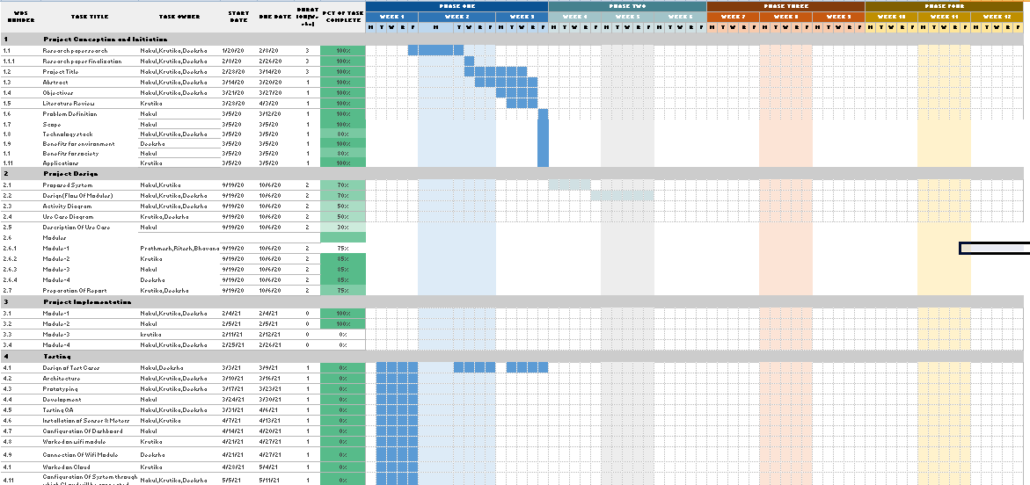
Gantt Chart

Slide 12
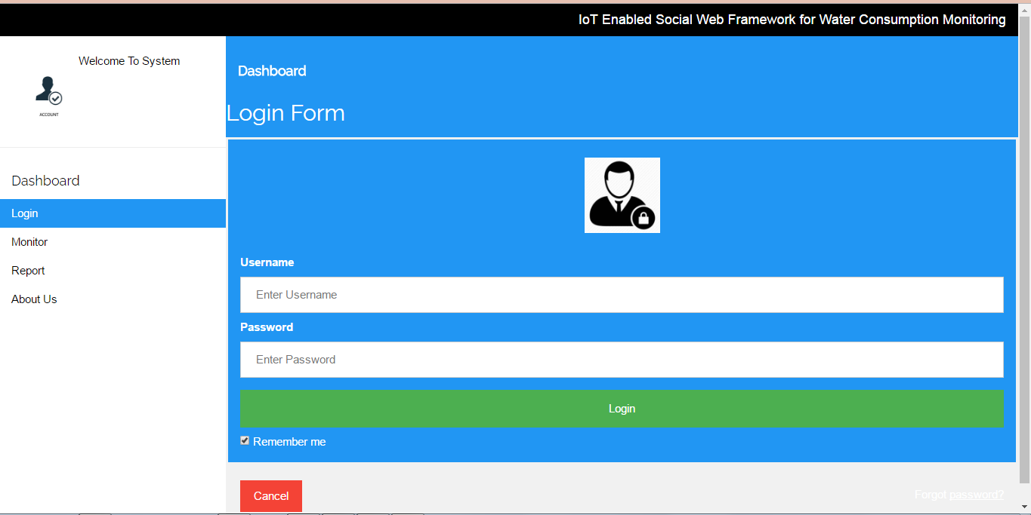
Prototype Design Demonstration
Website : Login Page

Slide 13
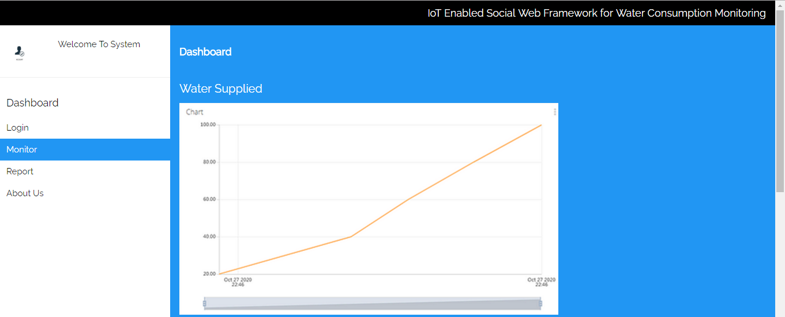
Webpage : Monitoring

Slide 14
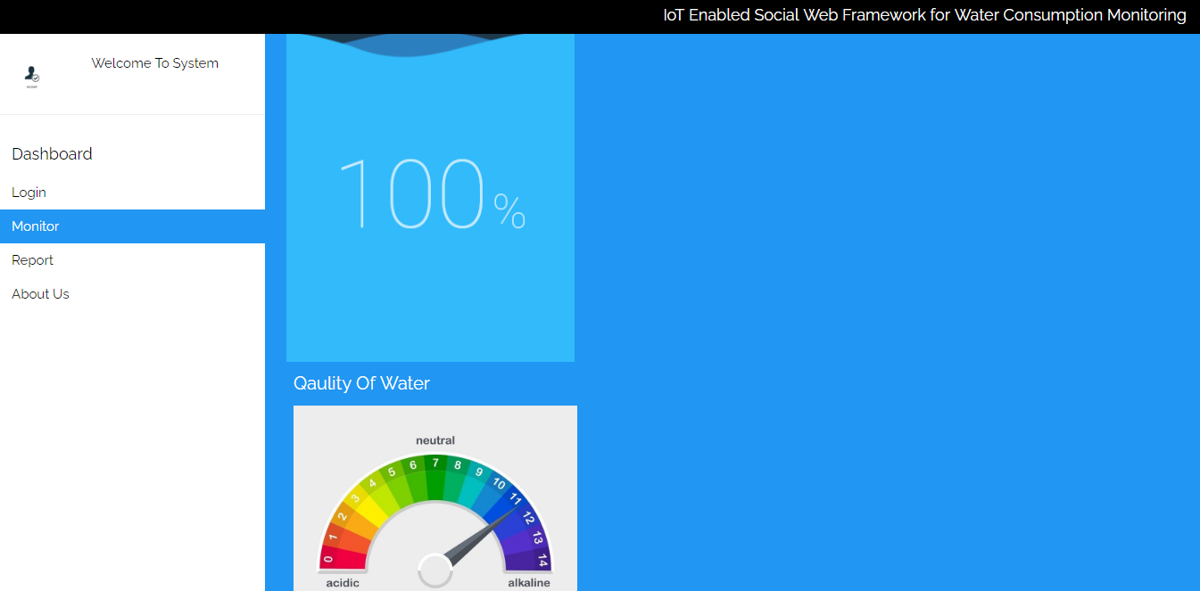
Webpage : Monitoring

Slide 15
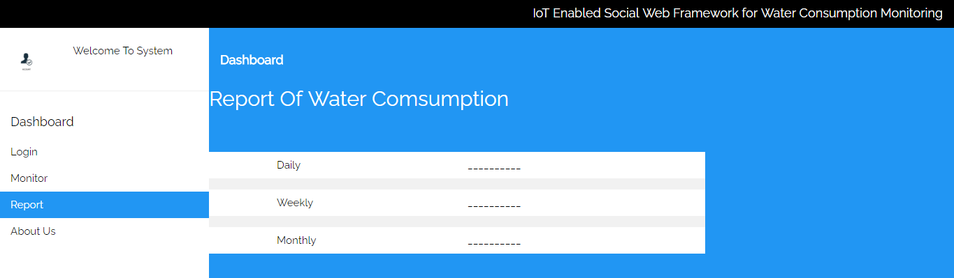
Webpage : Report

Slide 16
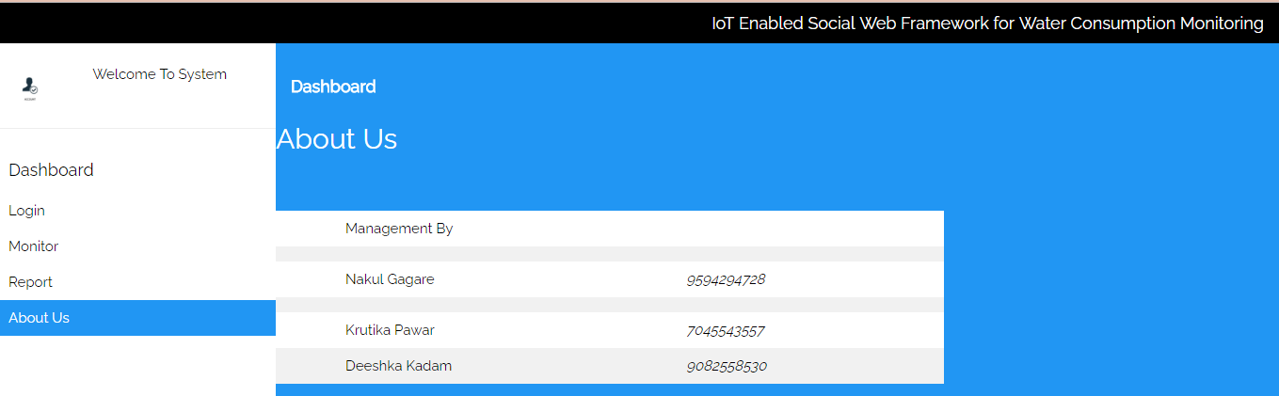
Webpage : About Us

Slide 17
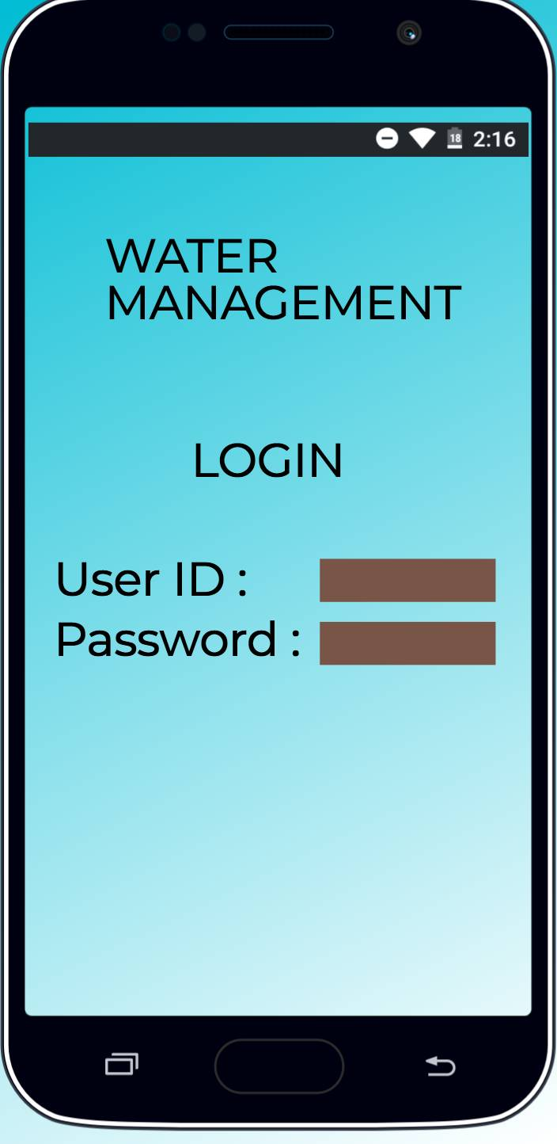
App For : Society Committee
LOGIN

Slide 18
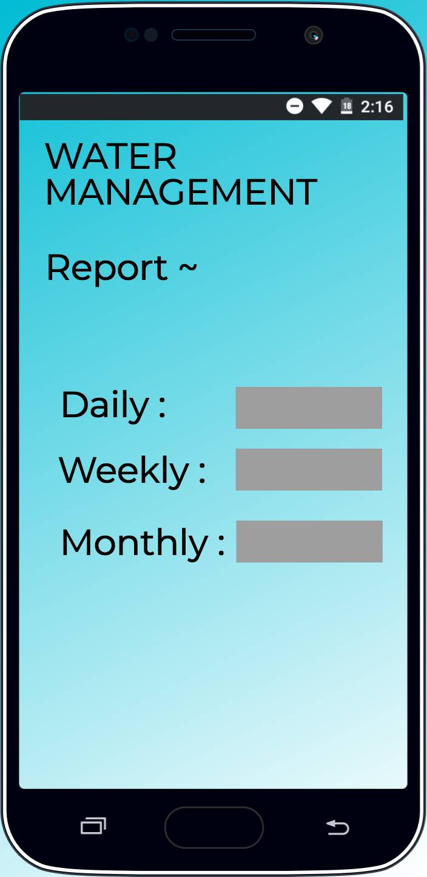
App For : Society Committee
Generated report from water department

Slide 19
Plan of Paper Publication
Springer :
Springer is a leading global scientific, technical and medical portfolio, providing researchers in academia, scientific institutions and corporate R&D departments with quality content through innovative information, products and services.
Submitted the Paper for the Springer Paper Publication
IEEE :
IEEE provides a wide range of quality publications that make the exchange of technical knowledge and information possible among technology professionals.
We are trying to publish paper because its improves writing skill, helps in knowledge up-gradation , teaches about literature survey & appreciate our work that will help in our career.

Slide 20
Thank You

